Slide 1
Accident and Incident Investigation

Slide 2
Objectives of this Section
●
To define the reasons for investigating accident and incidents.
To outline the process for effectively investigating accidents and incidents.
To facilitate an effective investigation.
●
●

Slide 3
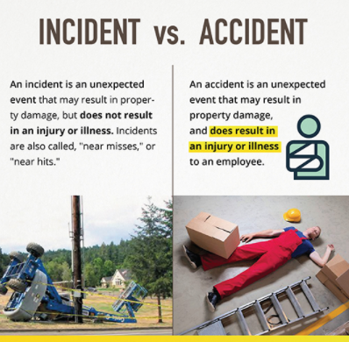
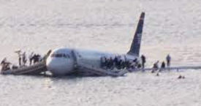
What is an accident?
What is an incident?
What is a near miss?
A near miss is an unintentional incident that could have caused damage, injury or death but was narrowly avoided

Slide 4
Accident Investigation
●
Important part of any safety management system. Highlights the reasons why accidents occur and how to prevent them.
The primary purpose of accident investigations is to improve health and safety performance by:
➢ Exploring the reasons for the event and identifying both the immediate and underlying causes;
●
➢ Identifying remedies to improve the health and safety management system by improving risk control, preventing a recurrence and reducing financial losses.

Slide 5
What to Investigate?
All accidents whether major or minor are caused.
●
●
Serious accidents have the same root causes as minor accidents as do incidents with a potential for serious loss. It is these root causes that bring about the accident, the severity is often a matter of chance.
●
Accident studies have shown
that there is a of less serious
consistently greater number
accidents than serious accidents and in the same way a greater number of incidents than accidents.

Slide 6
Many accident ratio studies have been undertaken and the one shown below is based on studies carried out by the Health & Safety Executive.
1
Major injury
Or illness
7
Minor injuries or illnesses
189
Non Injury Accidents/Illnesses

Slide 7
Accident Studies
●
In all cases the ‘non injury’ incidents had the potential to become events with more serious consequences.
●
Such ratios clearly demonstrate that safety effort should be aimed at all accidents including unsafe practices at the bottom of the pyramid, with a resulting improvement in upper tiers.
●
Peterson (1978) in defining the principles of safety management says that “an unsafe act, an unsafe condition, an accident are symptoms of something
wrong within the management’s system.”

Slide 8
Accident Studies
All events represent a degree of failure in control and are potential learning experiences. It therefore follows that all accidents should be investigated to some extent.
●
●
This extent should be determined by the loss potential, rather then just the immediate effect.

Slide 9
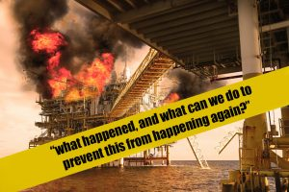

Slide 10
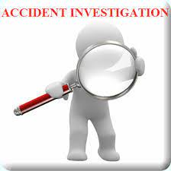
Stages in an Accident/Incident
Investigation
The stages in an accident/incident investigation are shown in the following diagram.
Deal with immediate risks.
Select the level of investigation.
Investigate the event.
Record and analyse the results.
Review the process.

Slide 11
Dealing with Immediate
Risks
Deal with immediate risks.
When accidents
and action
incidents may be
safe and necessary
●
occur immediate
necessary to:
Select the level of investigation.
➢
Make the
situation
prevent further injury.
Investigate the event.
➢Help, treat and if rescue injured persons.
Record and analyse the results.
●
An effective response can only be made if it has been planned for in
advance.
Review the process.

Slide 12
Selecting the level of investigation
The greatest effort should be put into:
➢Those involving severe injuries, health or loss.
Deal with immediate risks.
ill-
➢Those which could have caused much greater harm or damage.
Select the level of investigation.
These types of accidents and incidents demand more careful investigation and management time. This can usually be achieved by:
Investigate the event.
Record and analyse the results.
➢
Looking underlying events.
more closely at the causes of significant
Review the process.
➢Assigning the responsibility for the
investigation of more significant events to more senior managers.

Slide 13
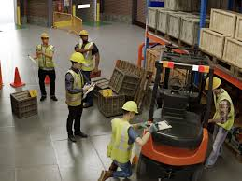

Investigating the Event
The purpose of investigations is to establish:
Deal with immediate risks.
Select the level of investigation.
●
The way things were and how they came to be.
What happened – the sequence of events that led to the outcome.
Investigate the event.
●
●
Why things happened as they did
and
Record and analyse the results.
analysing both the immediate
underlying causes.
Review the process.
●
What needs to be done to avoid a repetition and how this can be achieved.

Slide 14
A few sources should give the investigator all that is needed to know.
Documents
Information from:
Written instructions; Procedures, risk assessments, policies
Records of earlier inspections, tests, examinations and surveys.
Observation
Information from physical sources including:
Premises and place of work
Access & egress
Plant & substances in use
Location & relationship of physical particles
Any post event checks, sampling or reconstruction
•
•
•
Checking reliability, accuracy
Identifying conflicts and resolving differences Identifying gaps in evidence
Interviews
Information from:
Those involved and their line management;
Witnesses;
Those observed or involved prior to the event e.g. inspection & maintenance staff.

Slide 15

Interviews
Interviewing the person(s) involved and witnesses to the accident is of prime importance, ideally in familiar surroundings so as not to make the person uncomfortable.
The interview style is important with emphasis on prevention rather than blame.
The person(s) should give an account of what happened in their terms rather than the investigators.
●

Slide 16
Interviews
●
Interviews should be separate to stop people from influencing each other.
●
Questions when asked should not be intimidating as the investigator will be seen as aggressive and reflecting a blame culture.

Slide 17
Observation
The accident site should be inspected as soon as possible after the accident. Particular attention should/must be given to:
•
•
•
Positions of people.
Personnel protective equipment (PPE).
Tools and equipment, plant or substances in use.
Orderliness/Tidiness.
•

Slide 18
Documents
Documentation to be looked at includes:
●
Written instructions, procedures and risk assessments which should have been in operation and followed. The validity of these documents may need to be checked by interview. The main points to look for are:
Are they adequate/satisfactory?
Were they followed on this occasion?
Were people trained/competent to follow it?
●
Records of inspections, tests, examination and surveys undertaken before the event. These provide information on how and why the circumstances leading to the event arose.

Slide 19
Determining Causes
●
Collect all information and facts which surround the accident.
Immediate causes are obvious and easy to find. They are brought about by unsafe acts and conditions and are the ACTIVE FAILURES. Unsafe acts show poor safety attitudes and indicate a lack of proper training.
These unsafe acts and conditions are brought about by the so called ‘root causes’. These are the LATENT FAILURES and are brought about by failures in organisation and the management’s safety
system.
●
●

Slide 20
Determine what changes are needed
The investigation should determine what control measures were absent, inadequate or not implemented and so generate remedial action for implementation to correct this.

Slide 21
Recording & Analysing the
Results
●
Recorded in a similar and systematic manner.
Deal with immediate risks.
●
Provides a historical record of the accident.
Analysis of the causes and recommended preventative protective measures should be listed.
Completed as soon after the accident as possible.
Information on the accident and remedial
●
Select the level of investigation.
●
Investigate the event.
●
actions should be passed to all
Record and analyse the results.
supervisors.
●
Appropriate preventative measures may also have to be implemented by such supervisors.
Review the process.
●
Investigation reports and accident statistics should be analysed from time to time to identify common causes, features and trends not be apparent from looking at events in isolation.

Slide 22
Reviewing the Process
Reviewing the accident/incident investigation process should consider:
Deal with immediate risks.
–
–
The results of investigations and analysis.
The operation of the investigation system (in terms of quality and effectiveness).
Select the level of investigation.
Investigate the event.
Line managers should follow through and action the findings of investigations and analysis. Follow up systems should be established where necessary to keep progress under control.
Record and analyse the results.
Review the process.

Slide 23
The investigation system should be examined from time to time to check that it consistently delivers information in accordance with the stated objectives and standards. This usually requires:
●
Checking samples of investigation forms to verify the standard of investigation and the judgements made about causation and prioritisation of remedial actions.
Checking the numbers of incidents, near misses, injury and ill-health events;
Checking that all events are being reported.
●
●

Slide 24
Based on your knowledge learnt in your course, Identify the stages in an Accident/Incident Investigation related to your chosen case study.
Deal with immediate risks
Select level of investigation
Investigation of event
Record and Analysis
Review of process
In your case study, identify any related rules and regulation regarding to the accident reporting

Slide 25
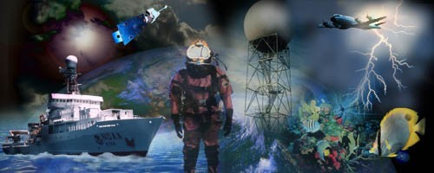
What is your definition of an “Accident”?

Slide 26
What is an Accident
an unplanned event
an unplanned incident involving injury or fatality
a series of events culminating in an unplanned and unforeseen event

Slide 27
How do Accidents occur?
- Accidents (with or without injuries) occur when a series of unrelated events coincide at a certain time and space.
-This can be from a few events to a series of a dozen or more
(Because the coincidence of the series of events is a matter of luck, actual accidents only happen infrequently)

Slide 28
Unsafe Acts
An unsafe act occurs in approx 85%- 95% of all analyzed accidents with injuries
An unsafe act is usually the last of a series of events before the accident occurs (it could occur at any step of the event)
By stopping or eliminating the unsafe act, we can stop the accident from occurring

Slide 29
What is an Accident Investigation?
●
A systematic approach to the identification of causal factors and implementation of corrective actions without placing blame on or finding personal fault. The information collected during an investigation is essential to determine trends and taking appropriate steps to prevent future accidents.

Slide 30
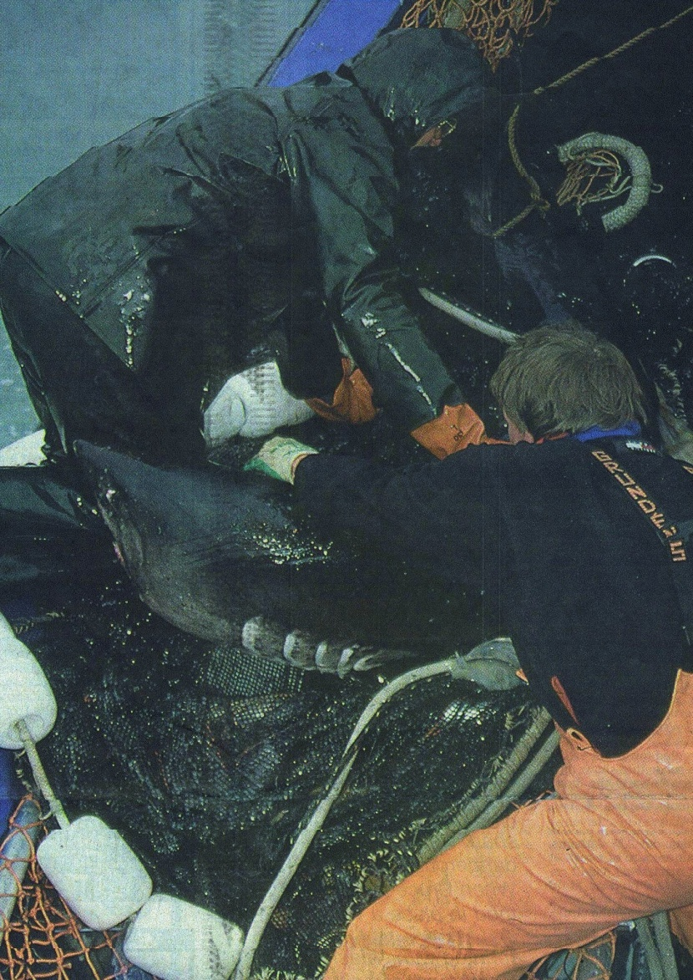
Which Accidents should be Recorded or Reported?
ALL accidents
(including illnesses) shall
be recorded and reported through the established procedures and guidance as provided by
NOAA Safety Division

Slide 31
Why Investigate Accidents?
Determine the cause
Develop and implement corrective actions Document the events
Meet legal requirements
●
●
●
●
Primary Focus:
PREVENT REOCCURENCE!!! PREVENT REOCCURENCE!!! PREVENT REOCCURENCE!!!

Slide 32
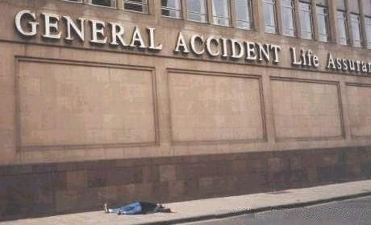
Accident vs. Near-Miss
Accident :
Any undesired, unplanned event arising out of a given work-related task which results in physical injury/ illness or damage to property.
Near-Miss :
Events which did not result in injury/illness or damage but had the potential to do so.

Slide 33
Accident Ratio Study
1
Serious or Disabling
10
Minor Injuries
30
Property Damage
600
Accidents with no visible injury or damage
6000
Unsafe Acts or Conditions

Slide 34
Accident Causes
Unsafe Act
an act by the injured person or another person (or both) which caused the accident,
and/or Unsafe Condition
some environmental or hazardous situation which caused the accident independent of the employee
●
●

Slide 35
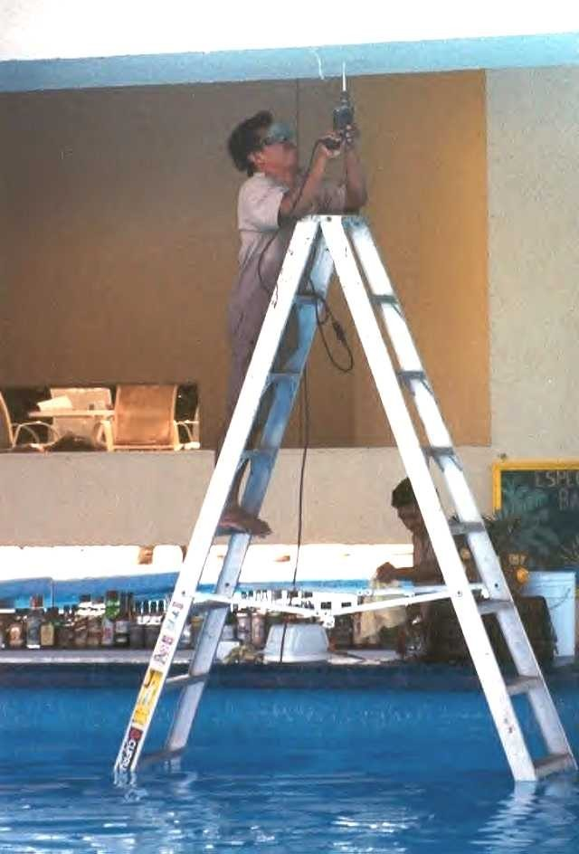
Accident Causation Model
■
Results of the accident
physical harm
property damage
Incident Occurrence
contact with
type
Immediate causes
practices
conditions
Basic causes
personal factors
job factors
supervisory performance
management policy and decisions
■
■
■

Slide 36


Results of the Accident
●
Physical Harm
catastrophic (multiple deaths)
single death
disabling
serious
minor
Property Damage
catastrophic
major
serious
minor
●

Slide 37
Incident Occurrence
●
Type
struck by
slip, trip
struck against
fell from
caught on - fell on same level
caught in - overexertion
●
Contact with
electricity
noise
hazmat
radiation
equipment
vibration
heat/cold
animals/insects

Slide 38
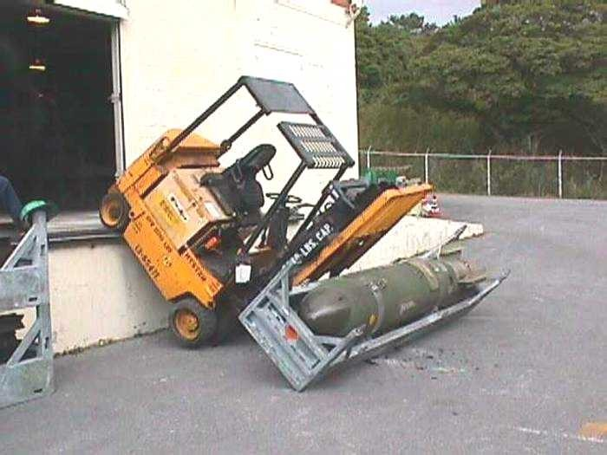
Immediate Causes
●
Practices
operating without authority
use equipment improperly
not using PPE when required
correct lifting procedures not established
drinking or drug use
horseplay
equipment not properly secured

Slide 39
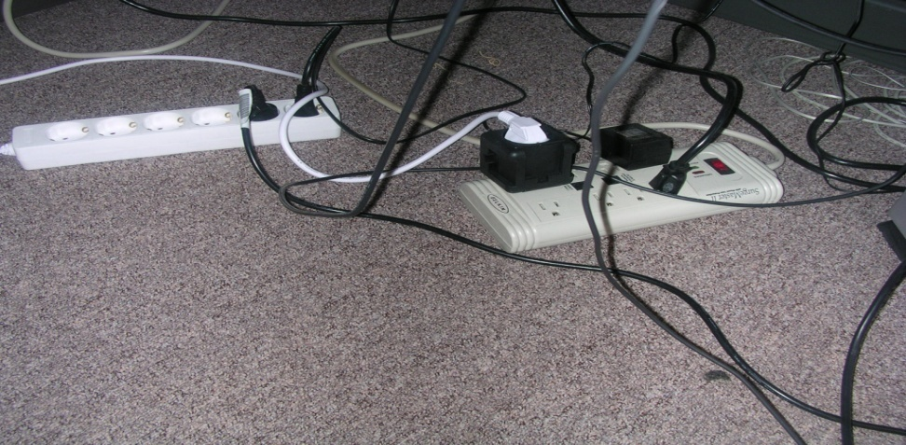

Immediate Causes (cont’d)
●
Conditions
ineffective guards
unserviceable tools and equipment
inadequate warning systems
bad housekeeping practices
poor work space illumination
unhealthy work environment

Slide 40
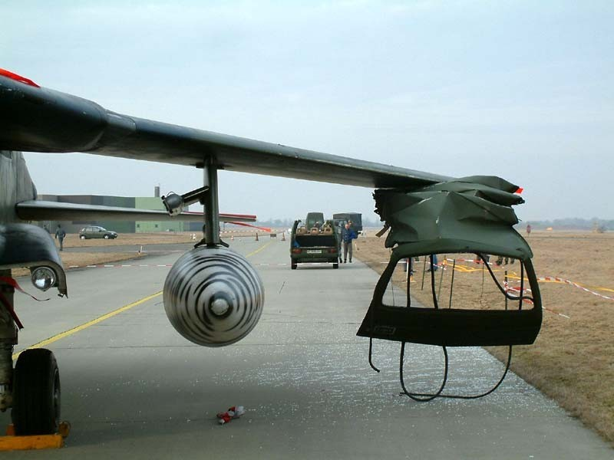
Basic Causes
●
Personal Factors
lack of knowledge or skill
improper motivation
physical or mental condition
literacy or ability
●
Job Factors
Physical environment
sub-standard equipment
abnormal usage
wear and tear
inadequate standards
design and maintenance

Slide 41
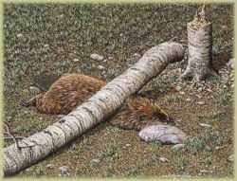
Basic Causes (cont’d)
●
Supervisory Performance
inadequate instructions
failure of SOPs
rules not enforced
hazards not corrected
devices not provided
●
Management Policy and Decisions
set measurable standards
measure work in progress
evaluate work vs. standards
correct performance
No animals were hurt as a result of this accident

Slide 42
Severity of Incident
(NOAA Safety Policy NAO-209-1)
Major
Employee fatality,
Hospitalization of 3 or more employees,
Permanent employee disability,
Five or more lost workdays,
Conditions that could pose an imminent and threat of serious injury/illness to other employees
Property losses in excess of $1 Million
●
●
Minor
- All other (less serious) incidents and unsafe conditions reported by employees

Slide 43
Who Investigates?
Major Accidents
NOAA “GO TEAM” Investigation Team
LO Representative
Other agencies such as NTSB, USCG, OSHA
●
Minor Accidents
First-Line Supervisor
Site Director or Manager
Site Safety Representative
NOAA SECO (if needed)
●

Slide 44
Investigator’s Qualifications
Technical knowledge Objectivity
Analytical approach
Familiarity with the job, process or operation Tact in communicating
Intellectual honesty Inquisitiveness and curiosity
●
●
●
●
●
●
●

Slide 45
When to Investigate?
Immediately after incident
Witness memories fade
Equipment and clues are moved
●
●
Finish investigation quickly

Slide 46
What to Investigate?
All accidents and near-misses
Conduct investigation upon first notification
Keeping the scene in-tact and
recording witnesses statements early is key to a successful investigation
●

Slide 47
Accident Investigation Kit
May Include:
Digital Camera
Report forms, clipboard, pens Barricade tape
Flashlight Tape measure Tape recorder
Personal Protective Equipment (as appropriate)
●
●
●
●
●
●
●

Slide 48
The Accident Occurs
●
Employee or co-worker immediately reports the accident to a supervisor
Supervisor secures/assesses the scene to prevent additional injuries to other employees, before assisting the injured employee
Supervisor treats the injury or seeks medical treatment for the injured
The accident scene is left intact
Site safety rep is contacted to assist the supervisor in the investigation of the accident.
●
●
●
●

Slide 49
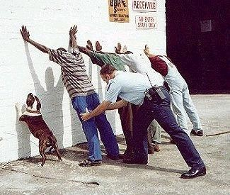
Beginning the Investigation
●
Gather investigation members and kit
Report to the scene
Look at the big picture
Record initial observations
Take pictures
●
●
●
●

Slide 50
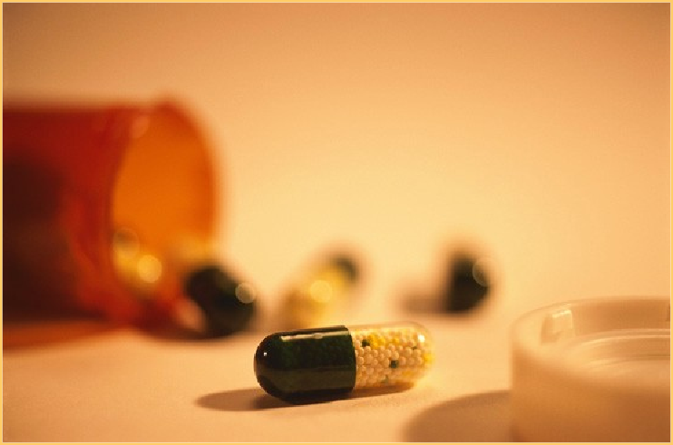
What’s Involved?
Who was injured?
Medication, drugs, or alcohol?
Was employee ill or fatigued?
Environmental conditions?
●
●
●
●

Slide 51
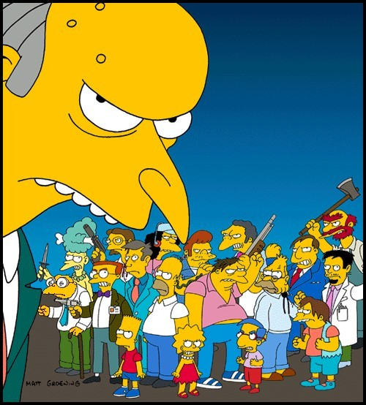
Witnesses
Who witnessed the accident?
Was a supervisor or Team Lead nearby?
Where were other employees?
Why didn’t anyone witness the accident
●
●
●
●
(working alone, remote areas)?

Slide 52
Interviewing Tips
●
Discuss what happened leading up to and after the accident
Encourage witnesses to describe the accident in their own words
Don’t be defensive or judgmental Use open-ended questions
Do not interrupt the witness
●
●
●
●

Slide 53
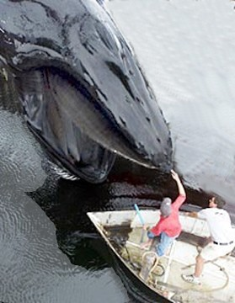
What was Involved?
●
Machine, tool, or equipment
Chemicals
Environmental conditions
Field season prep operations
●
●
●

Slide 54
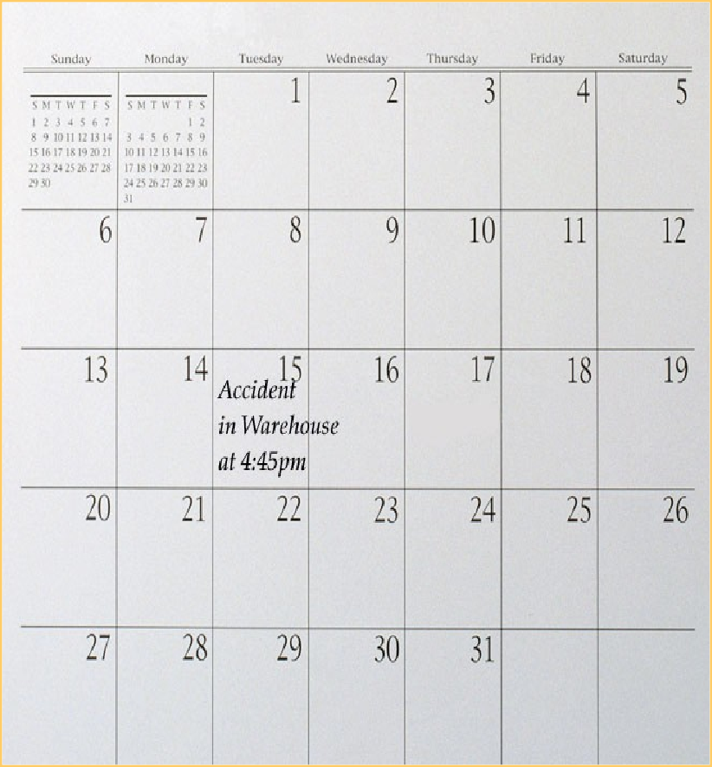
Time of Accident
Date and time? Normal shift or
●
●
working hours?
●
Employee coming off a vacation?

Slide 55
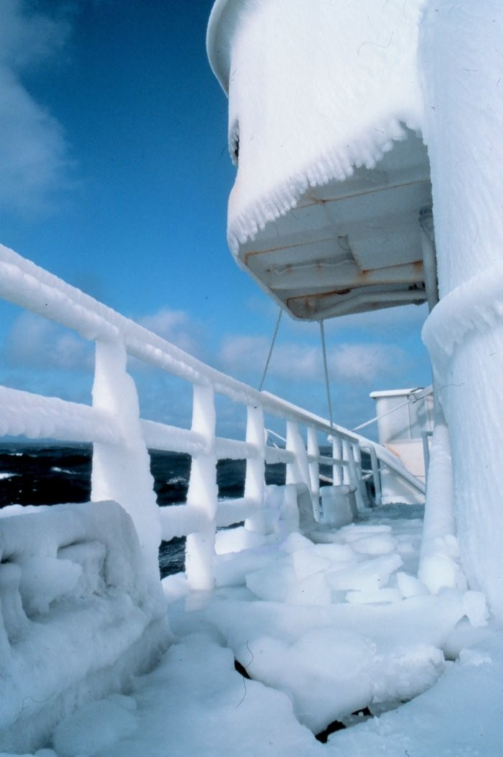
Accident Location
Work area
On, under, in, near Off-site address
Doing normal job duties
Performing non- routine or routine tasks (i.e., properly trained)
●
●
●
●
●

Slide 56

Accident Narrative
●
Describe the details so the reader can clearly picture the accident
Specific body parts affected
●
Specific motions of injured employee just before,
during, and after accident
●

Slide 57
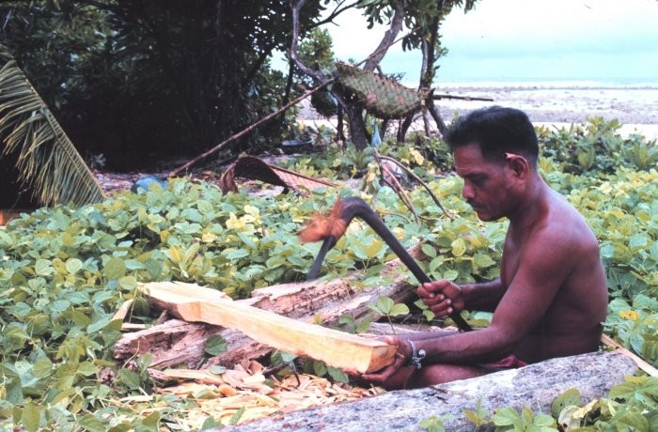
Employee’s Activity
●
Motion conducted at time of accident
Repetitive motion?
Type of material being handled
●
●

Slide 58

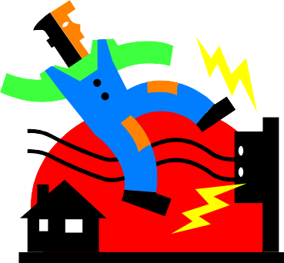
Causal Factors
Try not to accept single cause theory Identify underlying causes (root) Primary cause
Secondary causes
Contributing causes
Effects
●
●
●
●

Slide 59
Corrective Actions Taken
●
Include immediate interim controls implemented at the time of accident
Recommended corrective actions
Employee training
Preventive maintenance activities
Better operating procedures
Hazard recognition (ORM)
Management awareness of risks involved
●

Slide 60



Immediate Notification
●
Supervisor shall complete the NOAA Web Based Accident/ Illness Report Form and submit within 24 hours of incident occurrence (8 hours for major incidents).

Slide 61
Accident Analysis Summary
Investigate accident immediately
Determine who was involved and who witnessed it
Ascertain what items or equipment were involved
Record detailed description Determine causal factors Implement corrective actions
●
●
●
●
●
●

Slide 62







